Slide 1
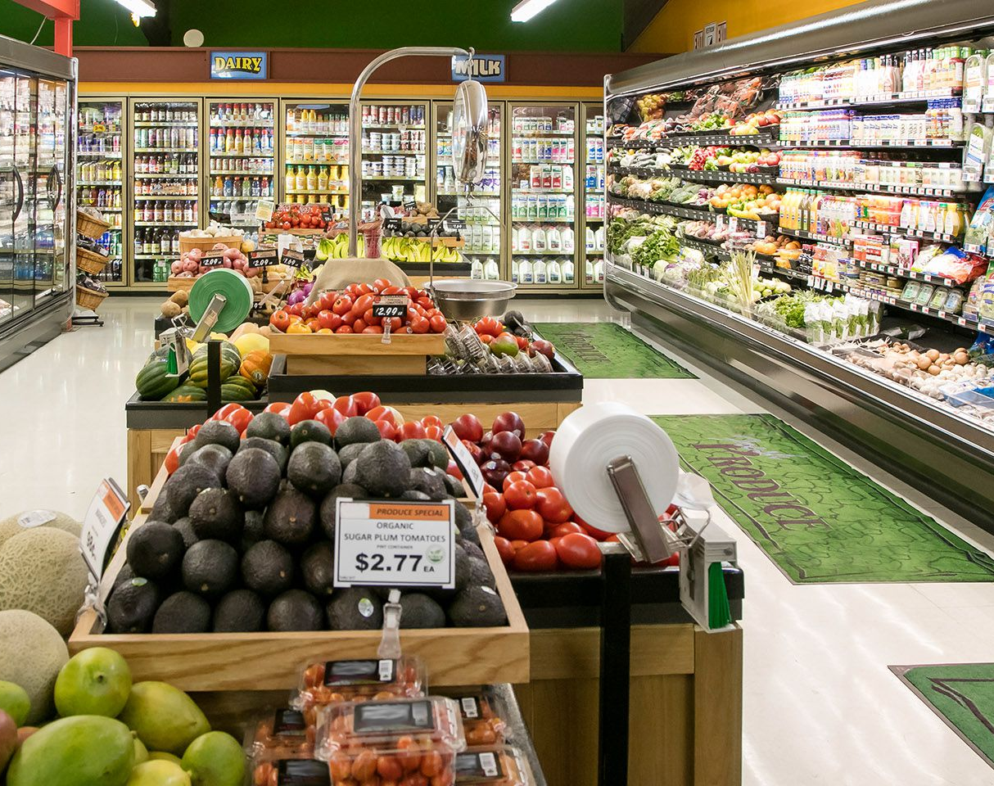
Marketing Campaign
Giridhar Reddy Kandala

Slide 2
Agenda
Business Context
Approach
Data Description
Exploratory Data Analysis
Classifier Evaluation
Conclusion

Slide 3
Business Context
Marketing is how a company raises awareness of its brand and convinces customers to make a purchase.
Marketing campaigns can be designed with different goals in mind, including building a brand image, introducing a new product, or increasing sales of a product already on the market.
It is essential that the business markets to the right customers to minimize costs and maximize profits.
Using Marketing Campaign Prediction, businesses can make informed decisions about marketing strategies that will result in a higher response rate.

Slide 4
Approach
Data Collection
Data Exploration
Prediction Modelling

Slide 5
Data Description
This dataset contains 2240 data points related to customer information.
The output variable has the information on the response to the marketing campaign.
The data period of the customer enrollment with the company ranges from July 2012 – June 2014.
The predictors in the model are demographic factors, previous campaign response, the amount spent on different products, number of purchases made using different channels.

Slide 6

Exploratory Data Analysis

Slide 7
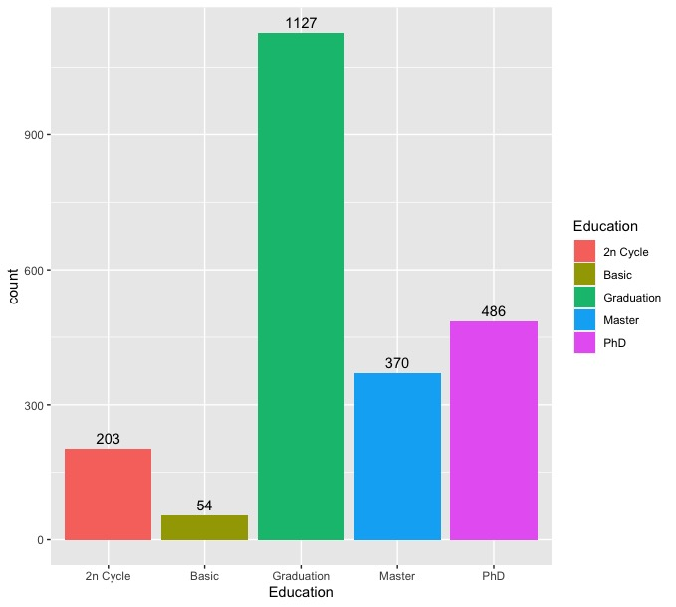
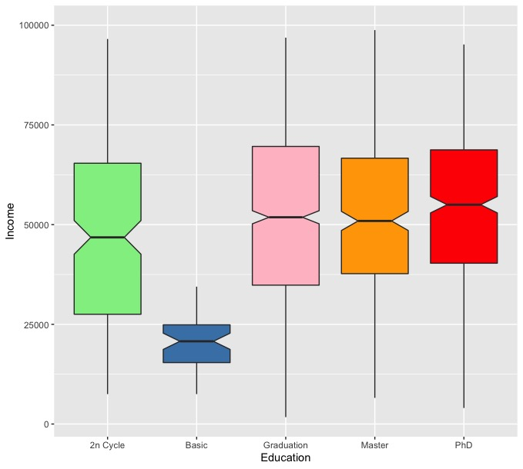
Analyzing customers Education vs Income
We can observe that customers who have Graduate degree are more.
It is seen that the Income is more for customers with a Graduate Degree.

Slide 8
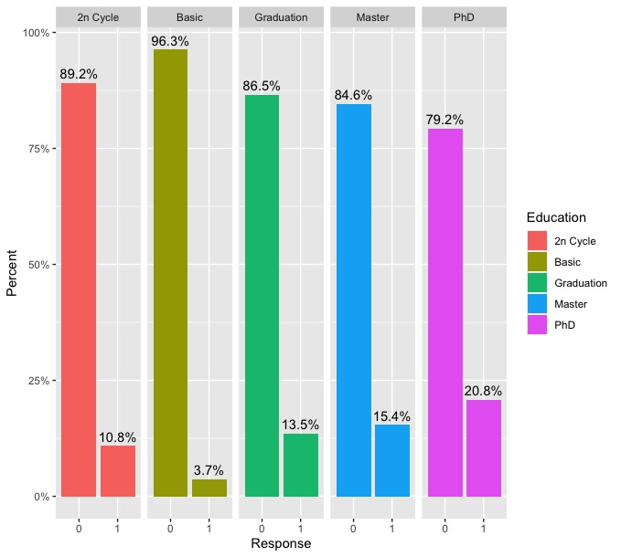
Analyzing customers Education vs Response Rate
We can observe that the response rate is more for customers having a PhD degree and a similar response rate for customers having a Graduate and Master degree.

Slide 9
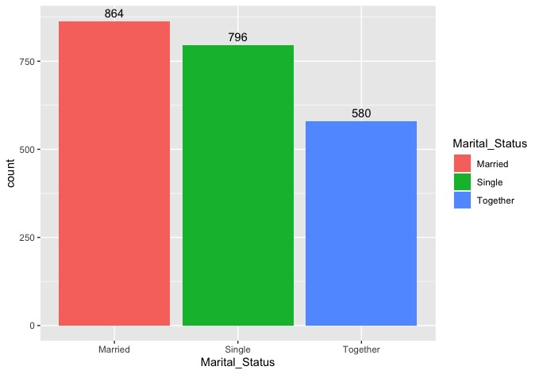
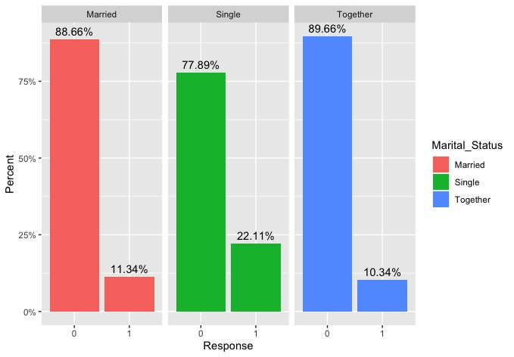
Analyzing customers Marital Status vs Response Rate
It is seen that Married customers are more when compared to the rest.
But the Response Rate is higher for customers who are single and lower for customers who are married and together.

Slide 10
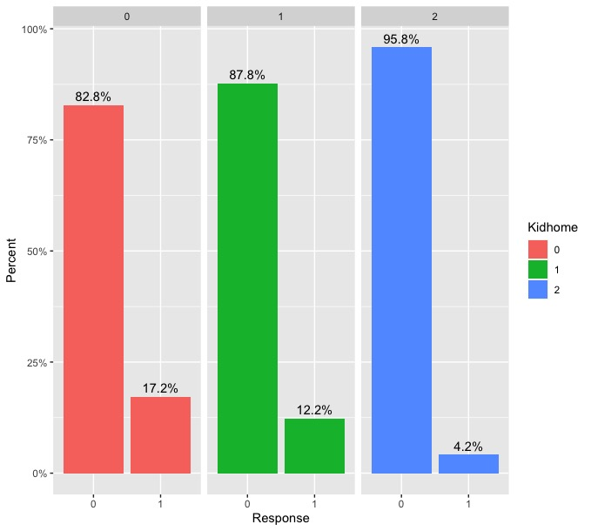
Analyzing Kids at Home vs Response Rate
We see that the customers who have no kids at home have a higher response rate.
But we can observe that the default rate is similar for customers who are married and single.

Slide 11
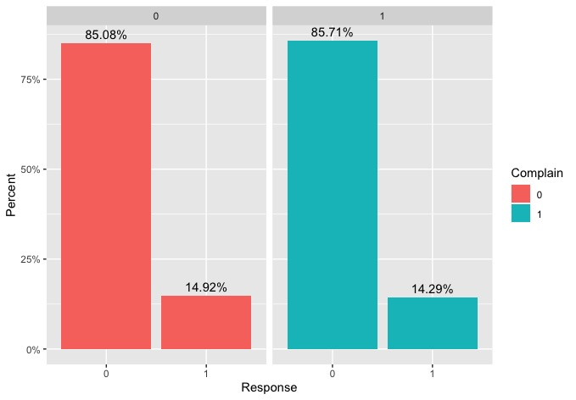
Analyzing Customers Complaints vs Response Rate
The response rate is similar for customers who have complained and also for customers who did not complain.

Slide 12
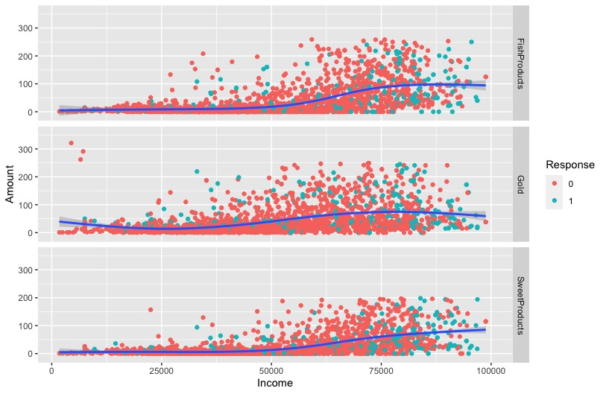
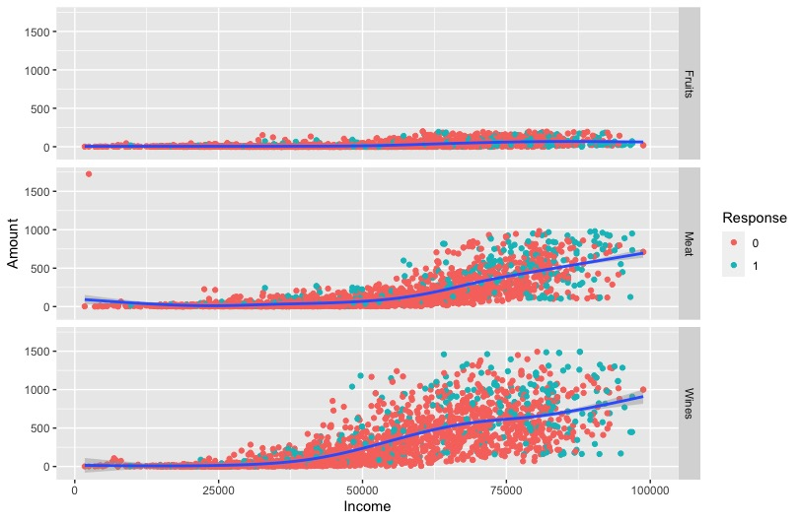
Analyzing customers Income with Amount Spent on Different Products
Fish
Fruits
Gold
Meat
Sweet
Wine

Slide 13
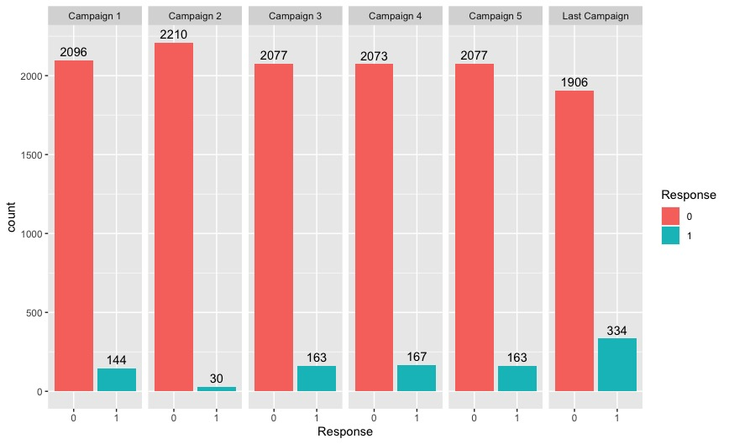
Analyzing Customers Response Rate For Different Campaigns

Slide 14

Classification
;

Slide 15
Prediction of Response
Predictors: Demographic factors, previous campaign response, the amount spent on different products, number of purchases made using different channels.
Models Utilized:
Logistic Regression
Clustering

Slide 16
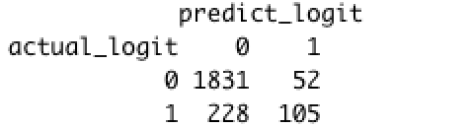
Model Evaluation
Upon evaluating the Logistic Regression model, it is observed that it has an accuracy of 87.36%.
Confusion Matrix:
Used to measure the performance of the classification model
True Positive Rate: 31.5%
True Negative Rate: 97.2%

Slide 17
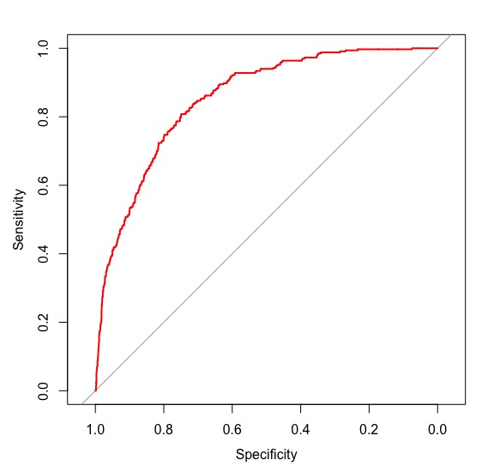
Model Evaluation
The same can be observed from the ROC curve.
It is observed the Area Under Curve is 85.29%.

Slide 18
Clustering
;

Slide 19
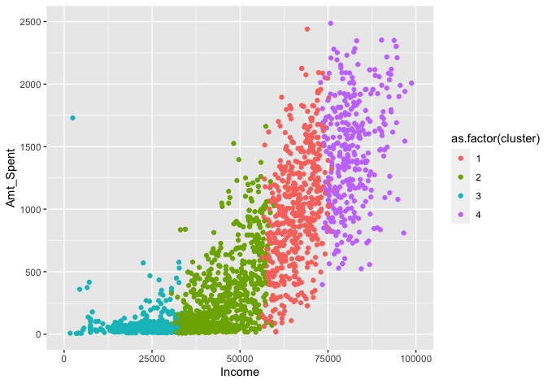
Analyzing Customers Complaints vs Response Rate
By clustering we can divide the customers into 4 segments:
Group 1: Low Income Low Expenditure
Group 2: Avg Income Low Expenditure
Group 3: Avg Income High Expenditure
Group 4: High Income High Expenditure

Slide 20

Recommendations
Promoting the campaign at least three times at minimum is recommended to increase the response rate from the customer.
The majority of wine products are bought by high-income consumers, so the marketing should target that group.
Marketing should be done on customers who are single and customers who are married with no kids because they respond to marketing campaigns.
There is no difference in the response rate between customers who have complained and those who haven't. It could indicate that the issue is not major, but the company needs to identify and address it in order to increase response rates.

Slide 21

Thank You!

